Slide 1

Office Management System
Practice School - I
\
External Supervisor
Faculty Supervisor
Dr. Gireesh Kumar Kaushik
Prepared By
Vardhana Sharma (2020BTechCSE081)
Mr. Lokendra Singh

Slide 2

Internship Projects
Project - 1
Office Management System

Slide 3
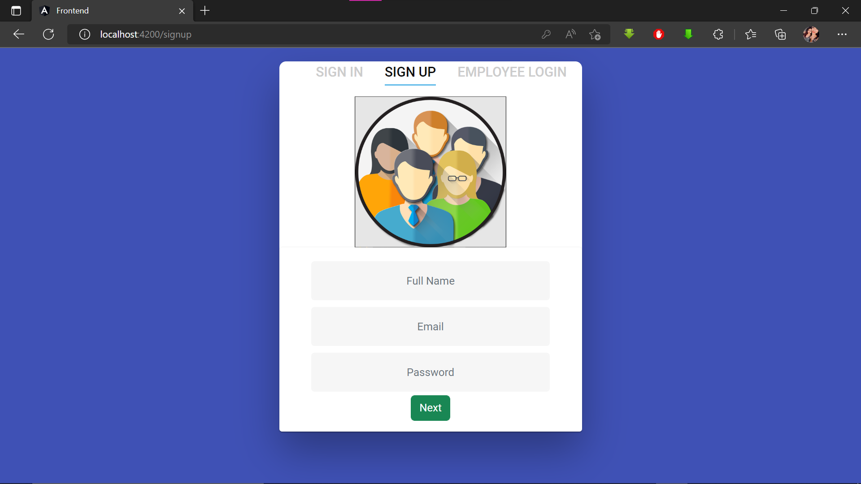
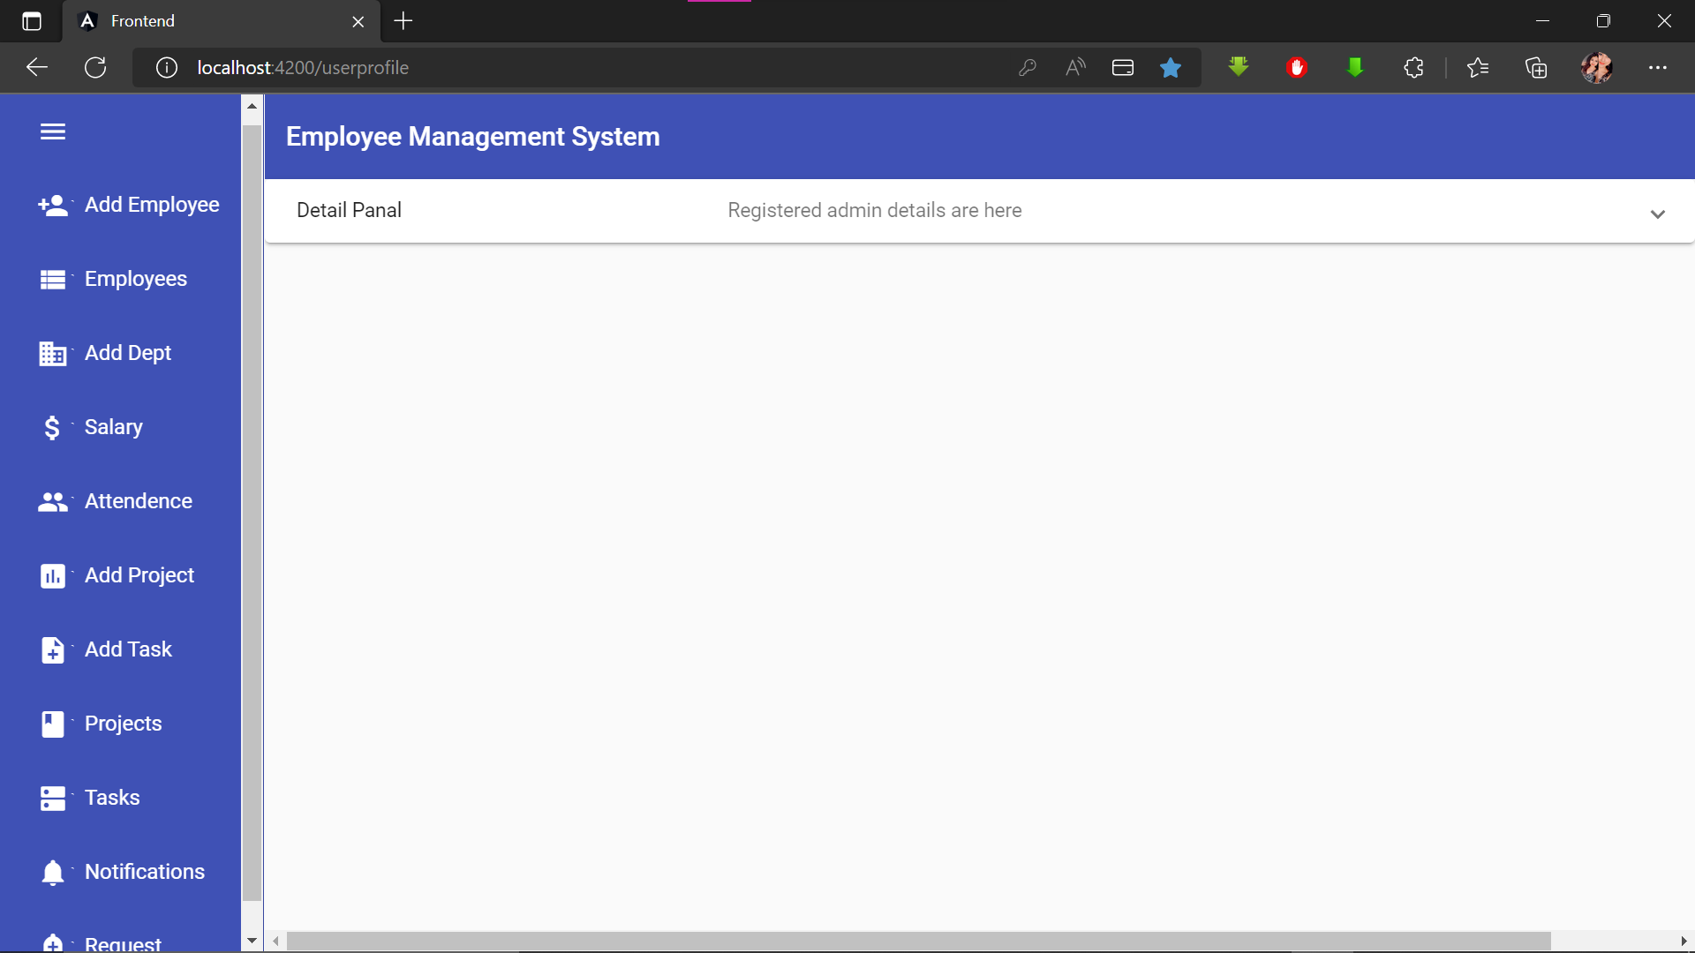
Project - 1
Office Management System
Motivation-
Manual handling of employee information and general office tasks poses a number of challenges.
This is evident in procedures such as details management where an employee is required to fill in a form which may take several weeks or months to be approved.
The Project details, progress tracking, tasks handling, attendance and notification management etc. is not an easy task to maintain and track. The use of paper work in handling some of these processes could lead to human error, papers may end up in the wrong hands and not forgetting the fact that this is time consuming.
A number of current systems lack employee self-service.

Slide 4
Project - 1
It handles all the office related work such as attendance management.
Project and its task as well as team management Notifications management
Task Progress tracking
It has the subscription facilitys that different companies can resgister and purchase plan (free/premium etc.) as per their requirement.
Companies dashboard will be dynamically updated with only those features which are included in the plan.
Payment can be done through stripe payment gateway integrated and many more.
Features-
The focused objective of “Office Management System” is designing a scheduling system for a work centre.
Proper Login/ Signup Authentication for Super admin, Registered company admin and the Employee
It is a distributed application, developed to maintain the details of employees working in any organization.
It maintains the information about the personal details of their employees.
It handles different departments in the office.

Slide 5
Project - 1
2) Company Admin- Can be accessed after sign up by taking subscription plan. All the employees details, multiple departments, salaries, promotions, attendance reports and notifications can be managed. Can add & manage all the projects along with teams. Assigning of tasks to project team members and their progress tracking can be done easily.
3) Employee Dashboard- Here, company wise employee can update their profile details, Can mark attendance & apply for leave. Can manage their assigned project tasks along with updating of its progress.
Dashboards
3 main dashboards are setups are there:
Super Admin Developer- Here, we have access to all the information about all the companies registered on the platform. Registered company management can be done here dynamically. Can create & manage multiple subscription plans with several features and employee limits, stripe payment gateway is integrated.

Slide 6
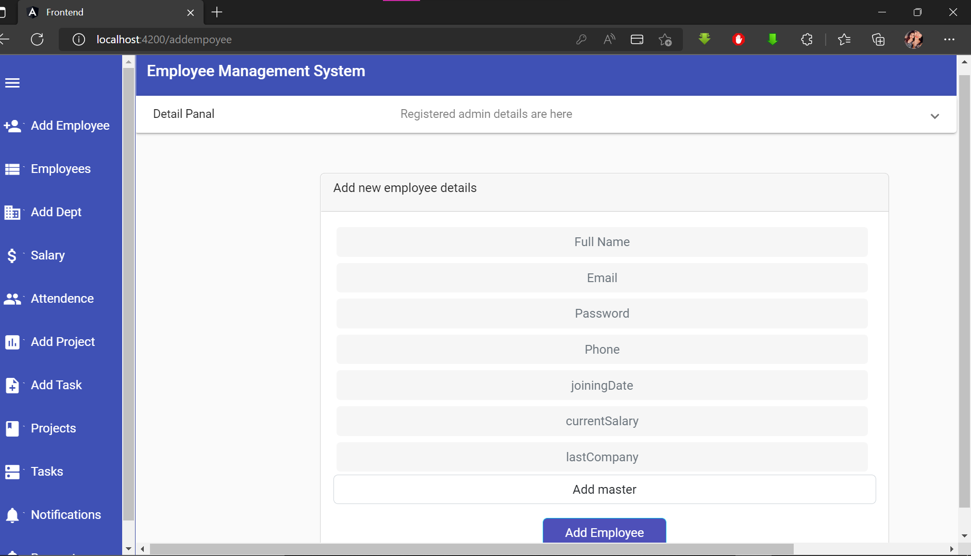
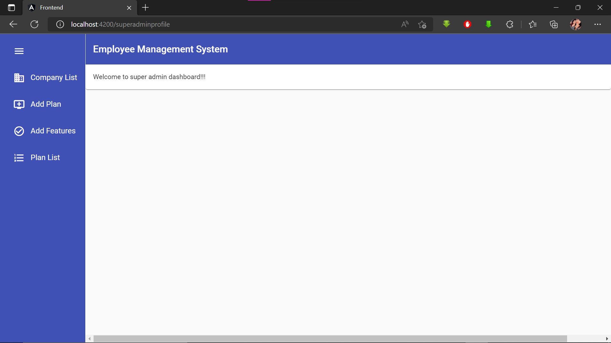
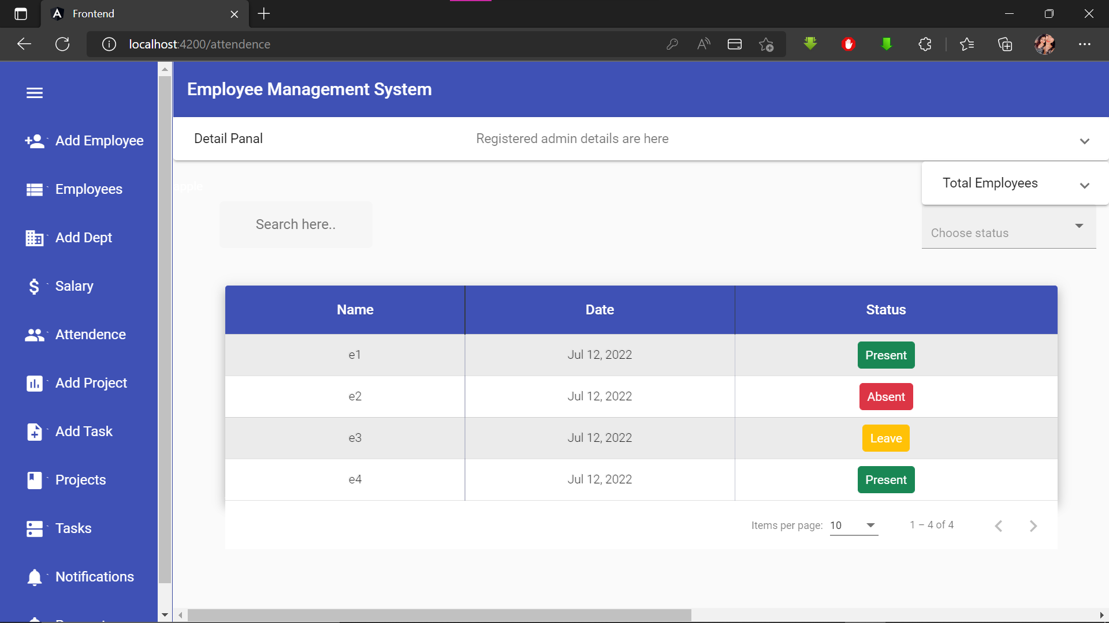
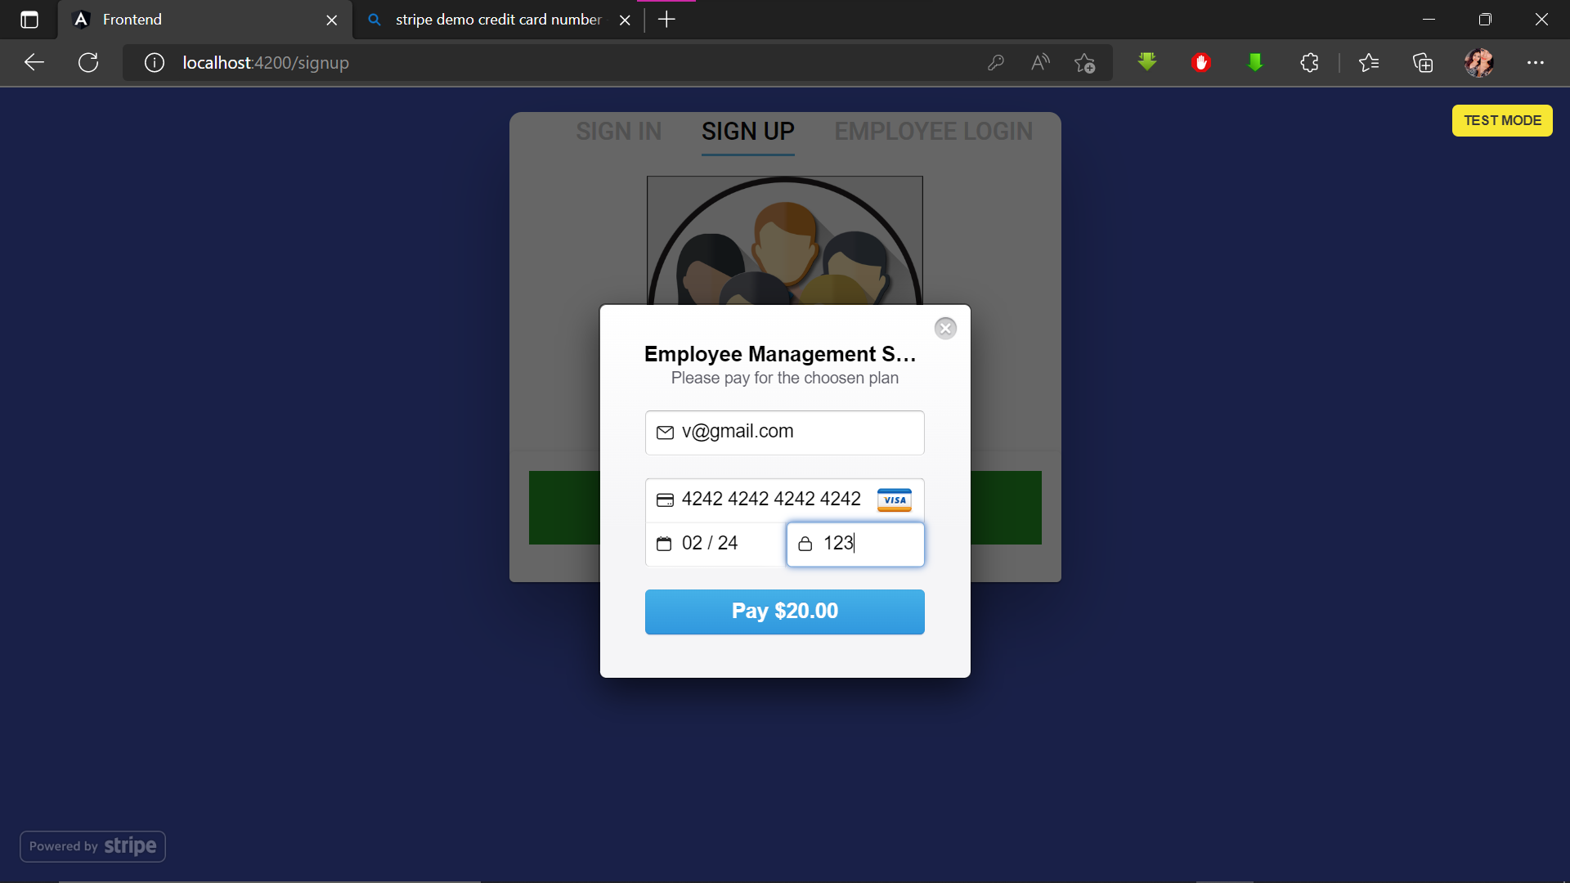
Project - 1
Screenshots

Slide 7
Project - 1
Database-
MongoDB
Payment Gateway-
Stripe
Technology Used-
Frontend and Backend-
Angular
Node JS
Material UI

